Slide 1
JavaScript
An introduction to JavaScript Programming

Slide 2
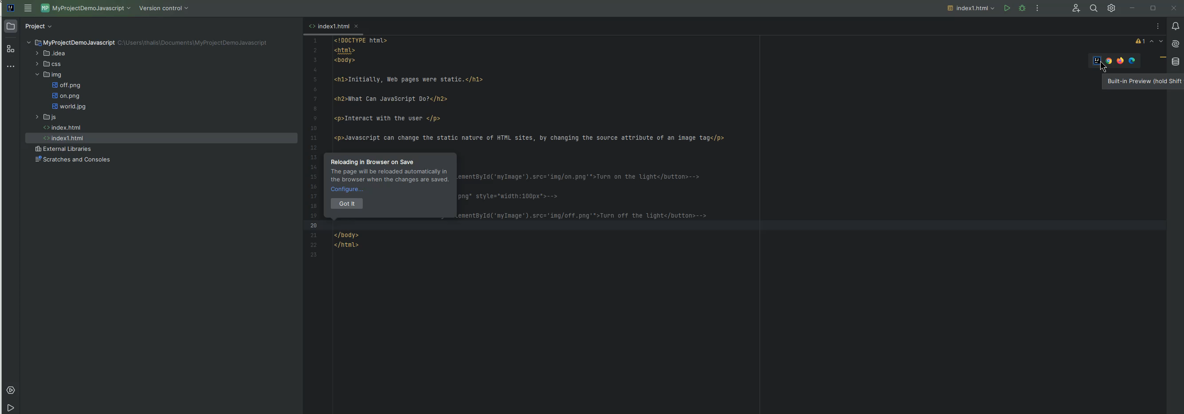
Why we need JavaScript?

Slide 3
Why we need JavaScript?
JavaScript is a high-level language like Python and Java
JavaScript, HTML and CSS are the primary languages used to build a website’s front-end applications
All browsers include a JavaScript engine to execute code
JavaScript can even be used for server-side operations with node.js

Slide 4
Main attributes and properties
JavaScript is a dynamically typed language
Is a weakly typed language and prototype-based (objects)
It is a multi-paradigm language, supporting functional and event-driven behavior
It has an application programming interface (API), for handling text, arrays and HTML Document Object Model (DOM)
JavaScript does not include input/output (I/O) module for networking, storage or any graphics interface

Slide 5
How to Add JavaScript into an HTML Document
Internal JavaScript
placed in head area of a document
<script> // code block </script>
External JavaScript
async: scripts with the async attribute are executed asynchronously defer: the script is downloaded in parallel while parsing the page
<script src = "scriptfile.js" async> </script>
<button onclick="createParagraph()"CLick!!</button>
Inline JavaScript

Slide 6
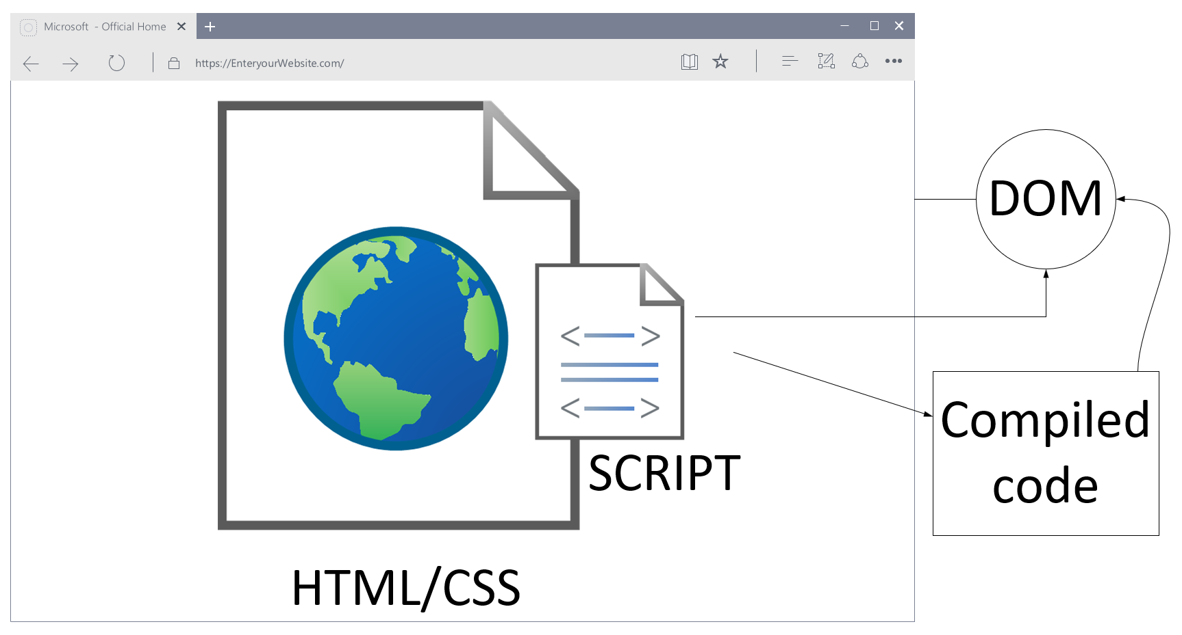
Just-in-time compiler (JIT)

Slide 7
JavaScript communication with user examples
console.log("Hello world!");
window.console.error(“Error");
window.alert("Hello world!");
//referencing the global object directly
alert("Hello world!");
//shorthand way
window.prompt("Are you feeling ok");

Slide 8
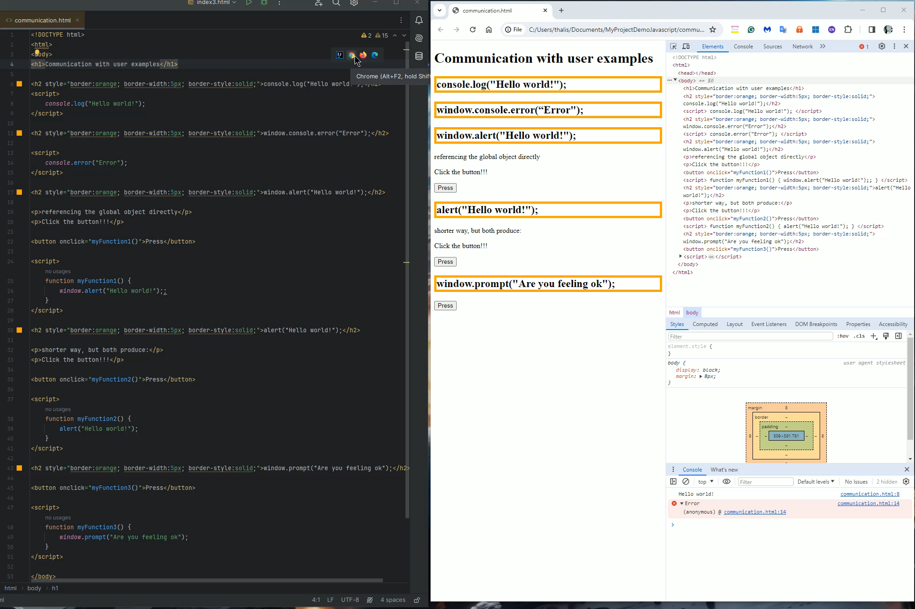
JavaScript communication with user examples

Slide 9
JavaScript engines
Every browser starts two processes for every web page
Rendering engine: it is responsible to display the web page. Parses the HTML and CSS and displays the content on the screen
JavaScript engine: This is where JavaScript code gets executed
JavaScript is interpreted, not a compiled language. Modern browsers use a technology called Just-In-Time (JIT) compilation that compiles the code to an executable bytecode.

Slide 10
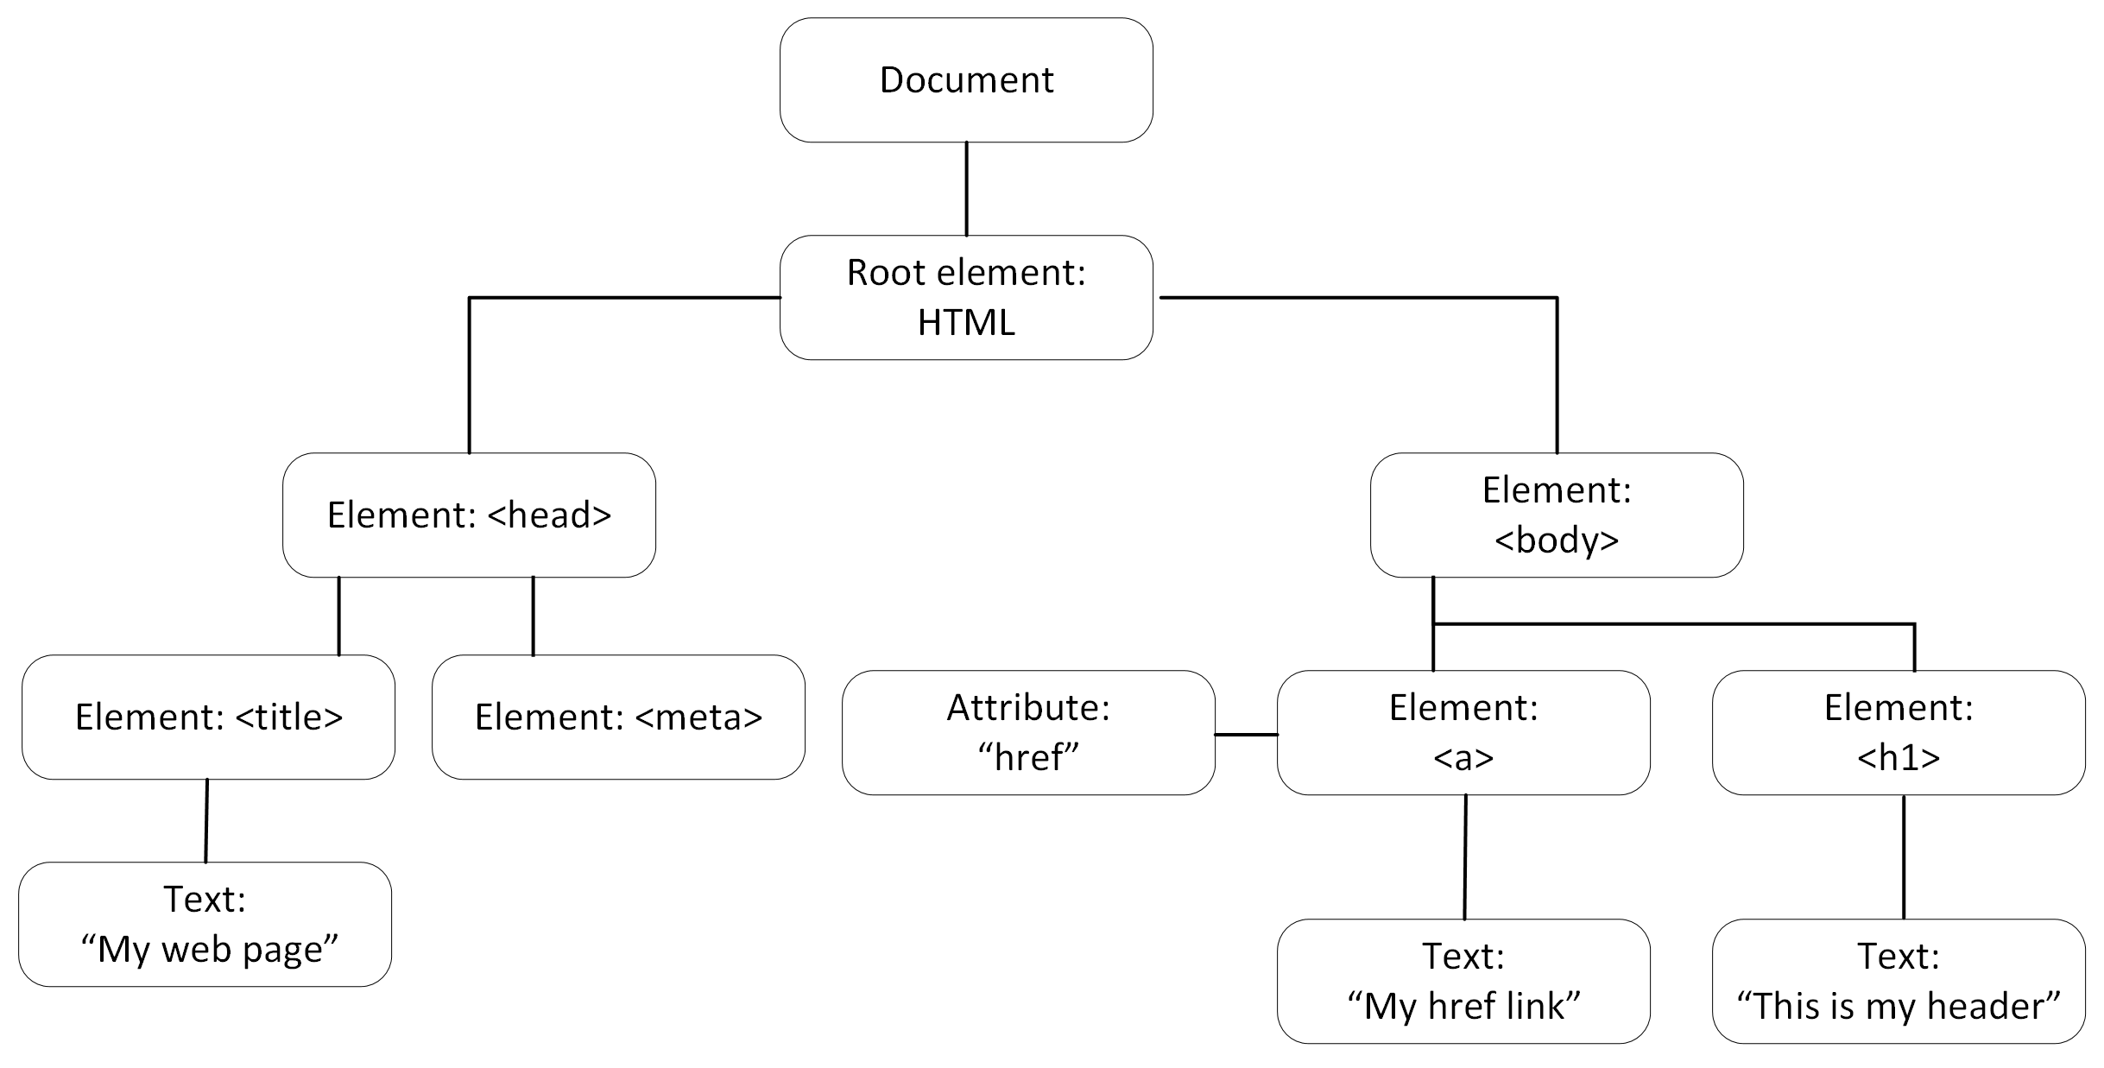
Document Object Model (DOM) tree structure

Slide 11
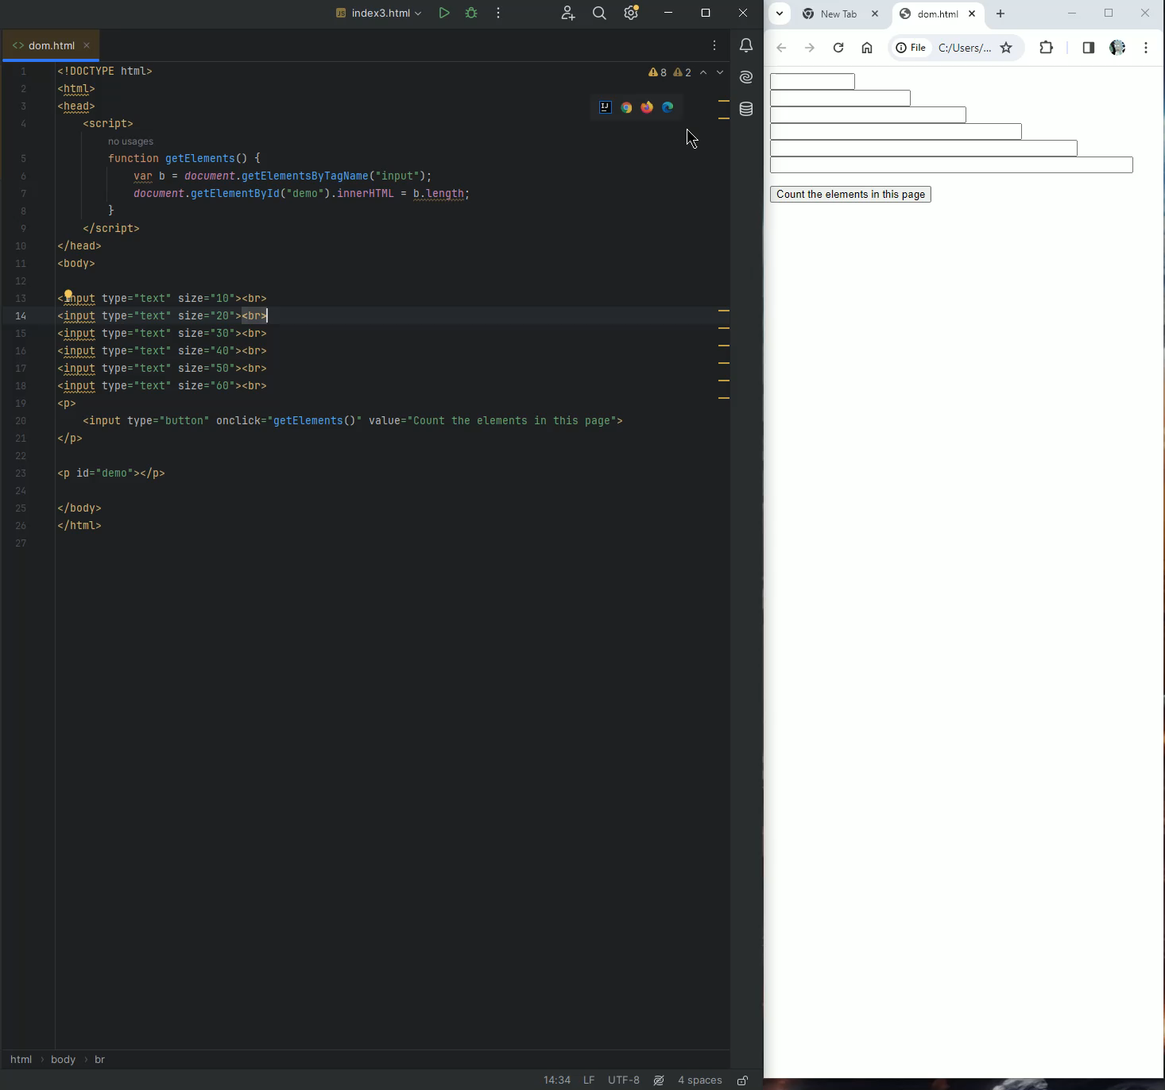
Can you count the elements in your structure?

Slide 12
DOM Manipulation in JavaScript
Navigator
(user agent)
<!DOCTYPE html>
<html>
<head>
<title>JavaScript Demo page</title>
</head>
<body>
<h2>This is an example of a Demo page with JavaScript</h2>
<p id="demo"></p>
<script>
document.getElementById("demo").innerHTML =
"The title of this document is: " + document.title;
</script>
</body>
</html>
Window
(tabs, Window.innerWidth Window.innerHeight
Main document
(DOM, HTML)

Slide 13
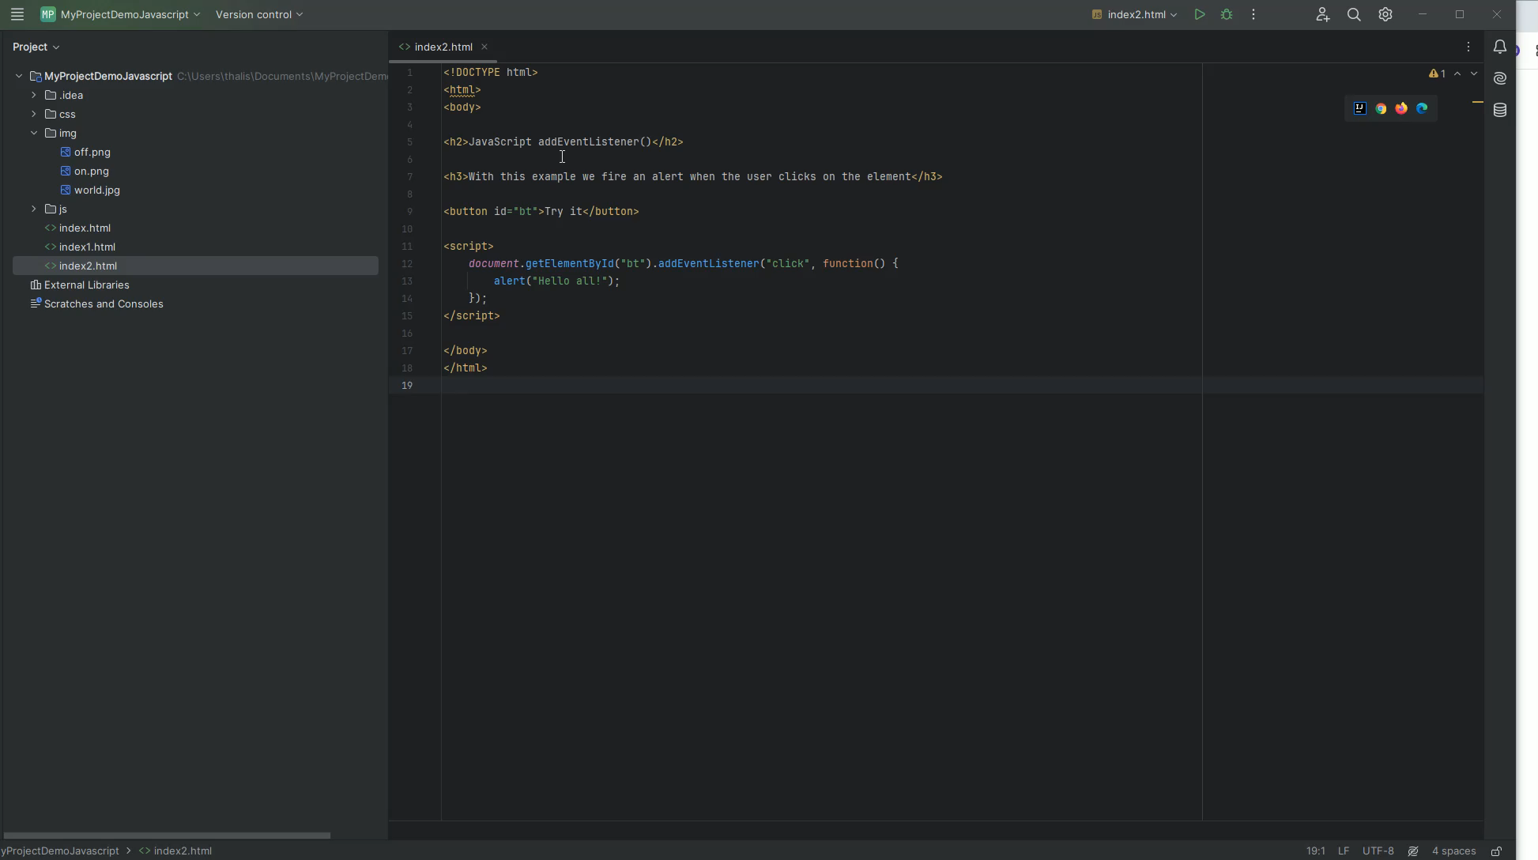
JavaScript HTML DOM EventListener

Slide 14
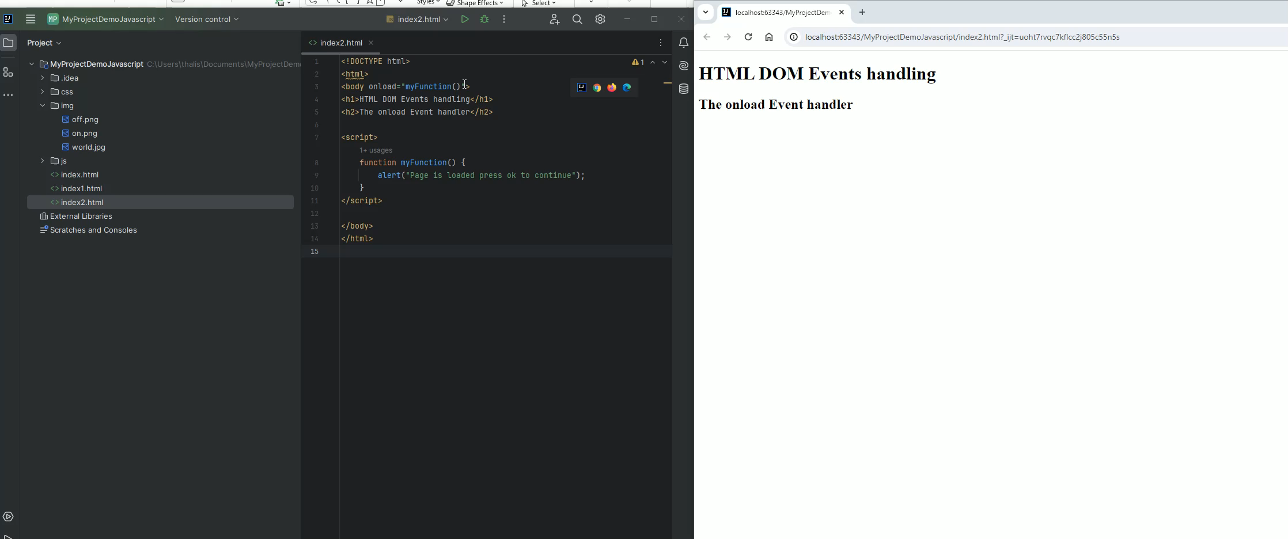
How to Make JavaScript Execute After HTML Load onload Event
If we use JavaScript to handle a Document Object Model (DOM) then our code executes after HTML (blocked code until OK!)

Slide 15
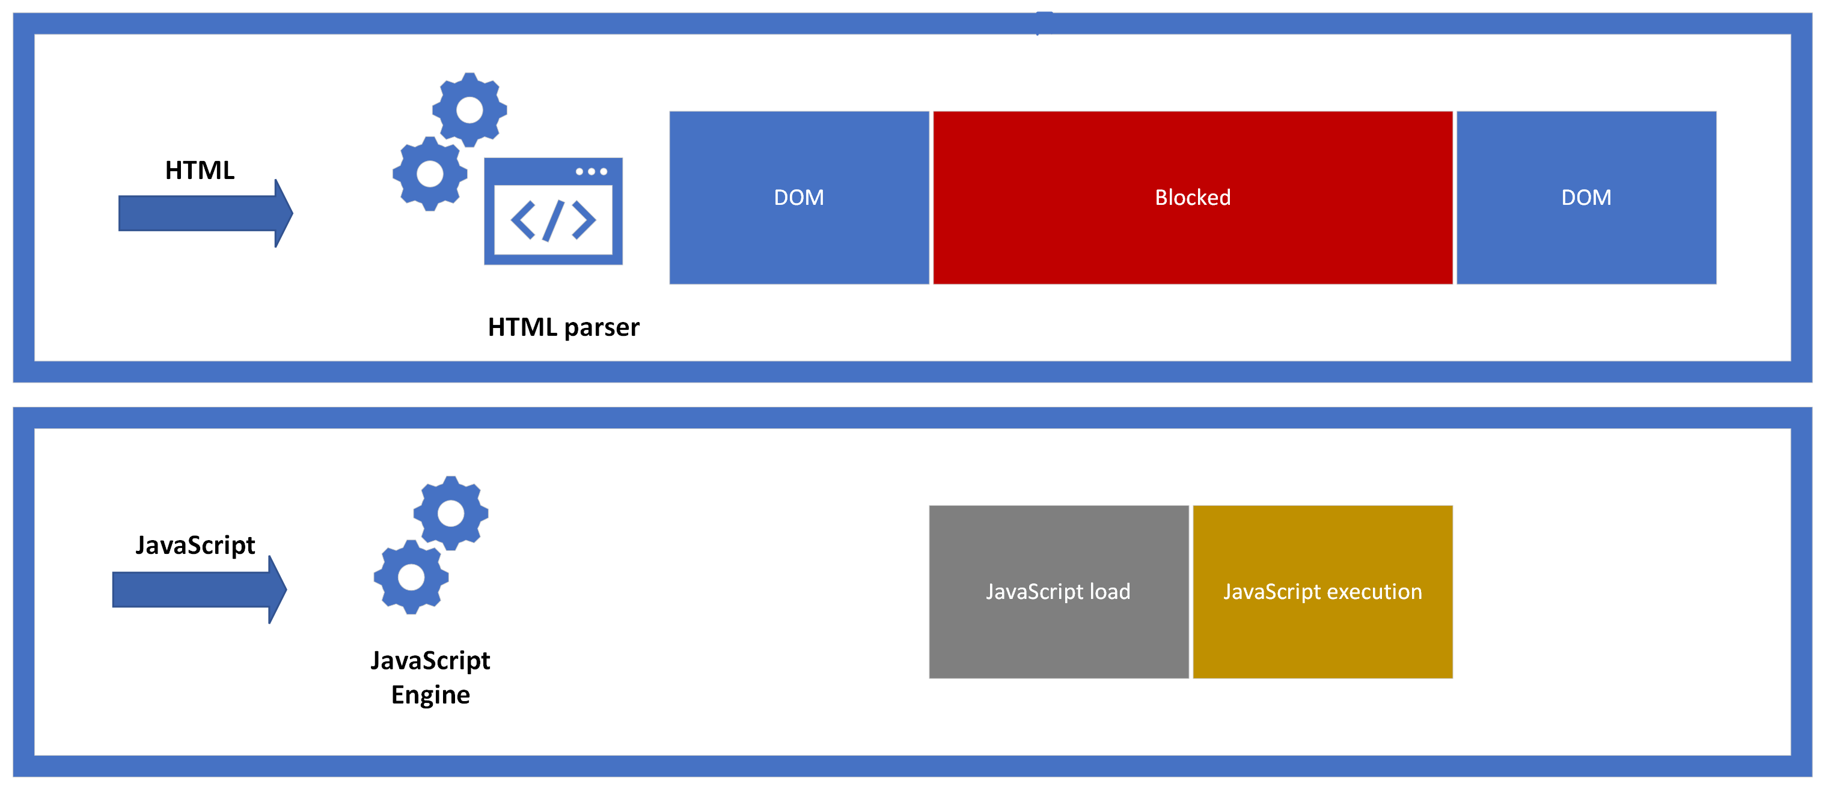
Execute JavaScript: parser-blocking scripts (synchronous)

Slide 16

Execute JavaScript: parser-blocking scripts (synchronous)

Slide 17
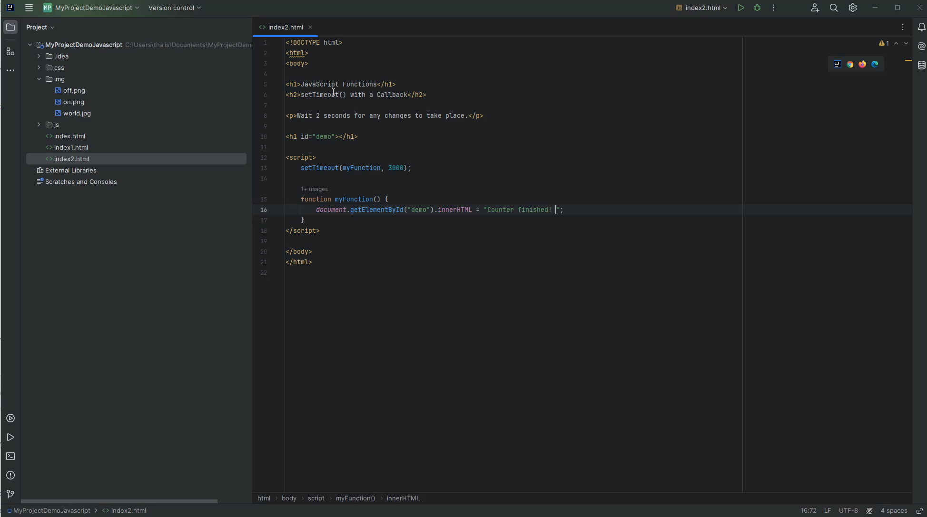
Asynchronous JavaScript
We can run function in parallel Asynchronously vs Synchronous coding:
is executed line by line (JavaScript has single thread execution)
each line waits for previous line to finish
long time operation

Slide 18
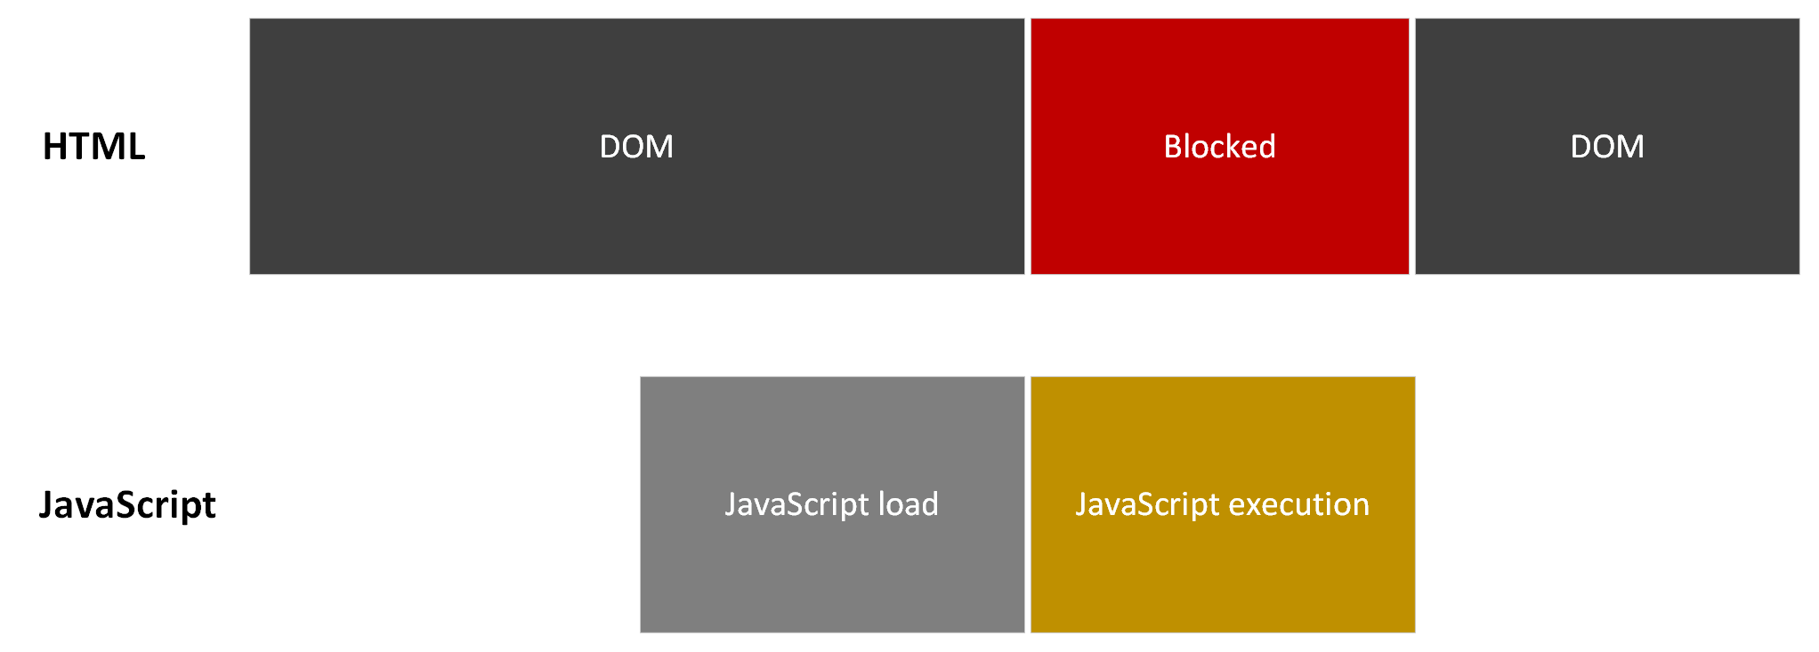
Asynchronous JavaScript

Slide 19
Variable Names
JavaScript variable names cannot include any Unicode character
First character can be any of a-z, A-Z or (_) or $
let $4 = 1; → Block
let _4 = 10;
var $_$ = "money"; → Function
var I_AM_HUNGRY = true;

Slide 20
typeof Operator
We can use the typeof operator to identify the data type of a Javascript variable:
let x= 10;
console.log(typeof x);
>number

Slide 21
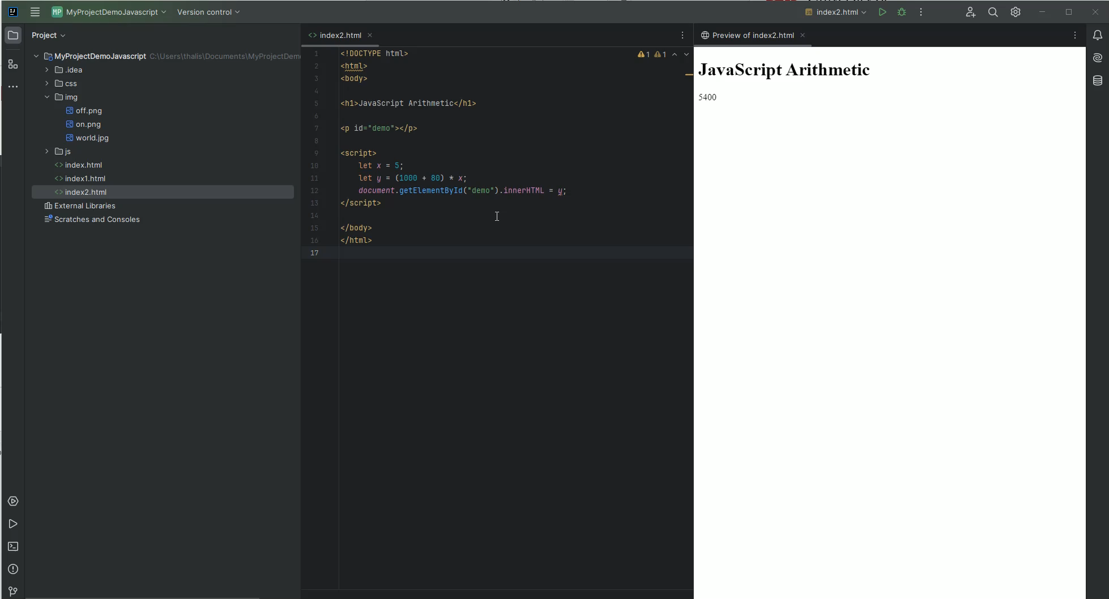
JavaScript Arithmetic Operators Demo

Slide 22
String in JavaScript
TELETYPE TEXT
Declare:
let abc = ‘hi all’; → The same
let def = ”hi
all”;
\ → escape point
let “I\’m feeling lucky”;
concatenate them using +
let one = “Hello”;
let two = “world!!!”;
let concatenation = one + two

Slide 23
String methods in JavaScript
let myName = 'Manolis
> myName.length;
7
> myName[0];
'M’
> myName[myName.length-1];
's’
> myName.slice(0,3);
'Man'
> myName.indexOf('lis');
4
> myName.slice(3);
'olis’
> myName.toLowerCase();
'manolis'
> myName.toUpperCase();
'MANOLIS’
> myName.replace('lis','s');
'Manos'

Slide 24
Arrays in JavaScript
Arrays are objects which can hold multiple values:
> let numbers = ['one', 'two', 'three'];
undefined
> numbers
[ 'one', 'two', 'three' ]
> let values = [1, 2, 3, 4, 5, 6, 10];
undefined
> let variety = ['one', 7896, [0, 1, 2]];
undefined
> variety
[ 'one', 7896, [ 0, 1, 2 ] ]

Slide 25
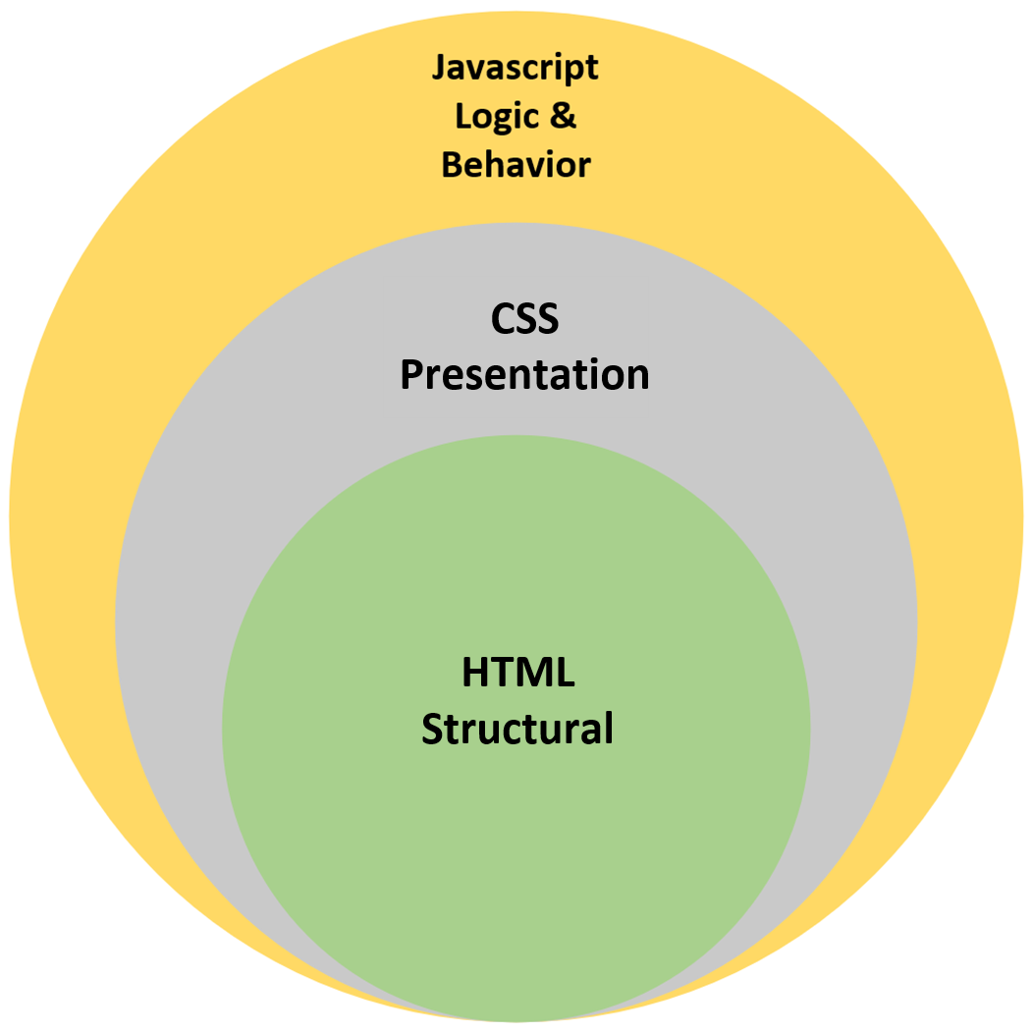
JavaScript and html
JavaScript is a scripting language utilized within an HTML document, to add functionality to the document or if you prefer to make a document dynamic.
With JavaScript, what we add complex features on web pages,
specifically, we can:
Dynamically update html page content
Control multimedia\images content of a page
Control, change text

Slide 26
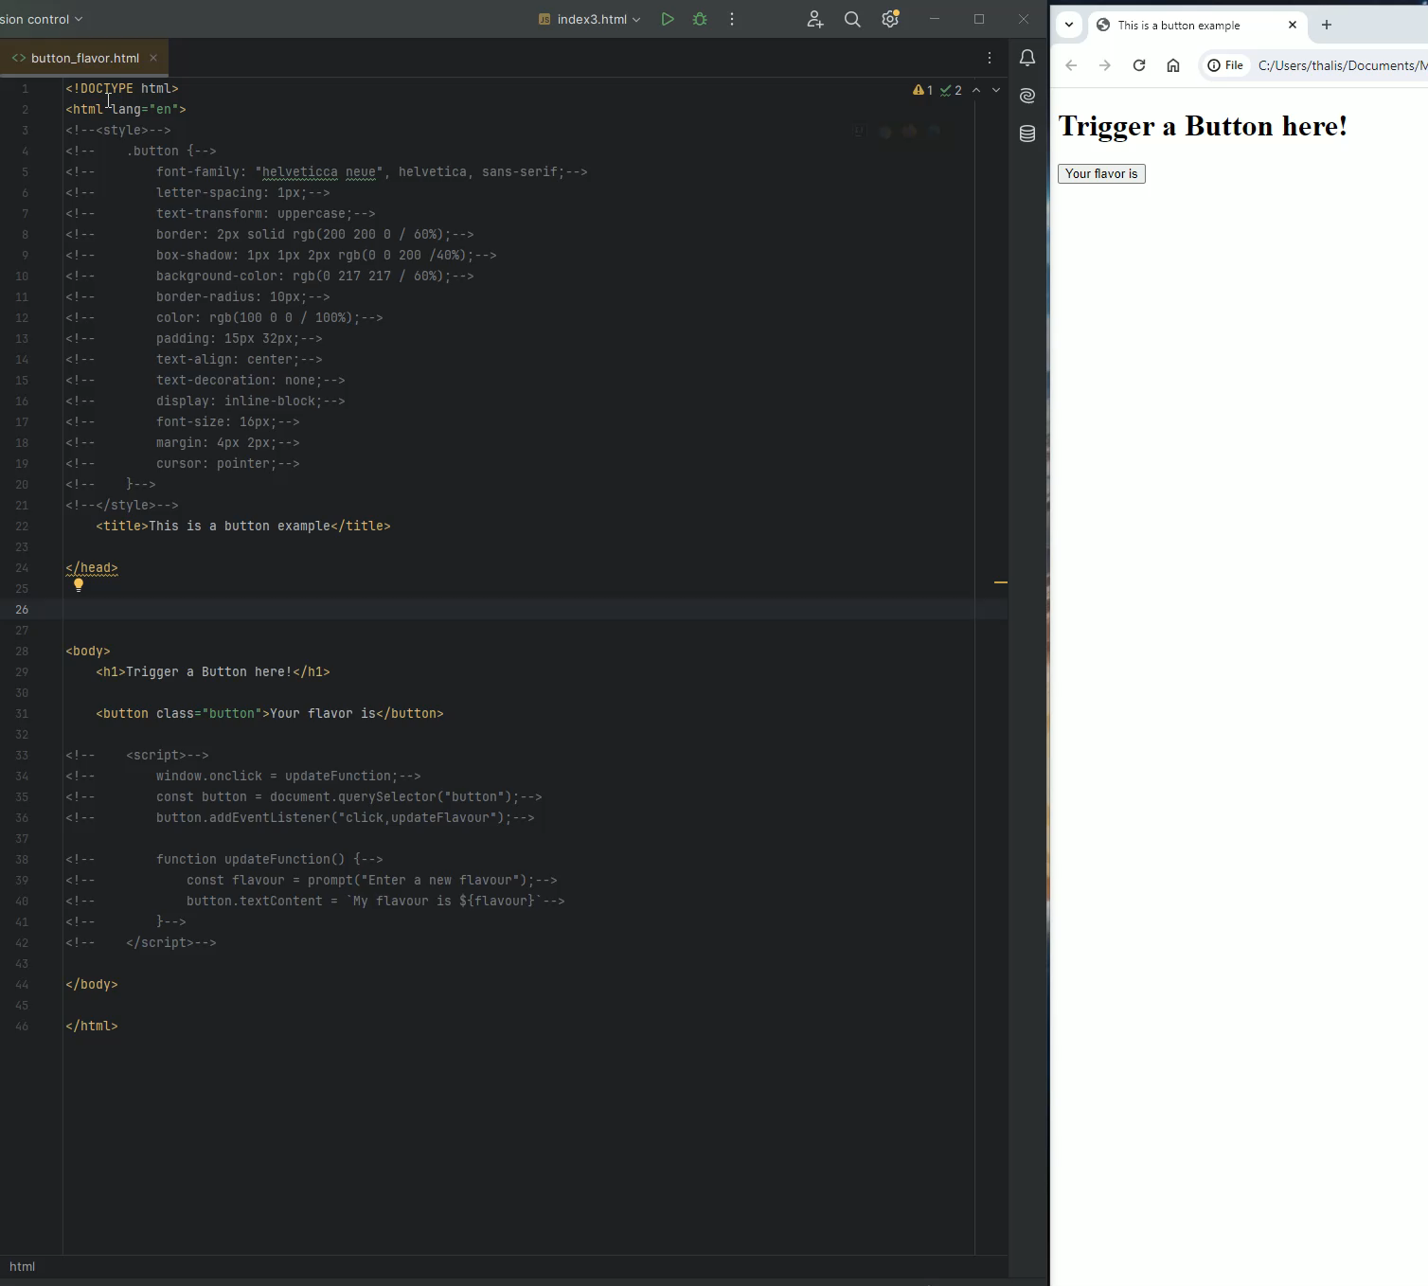
Trigger a click event JavaScript– Button example HTML

Slide 27
JavaScript Functions
Every function contains a set of instructions in a logical sequence so that a specific result is always achieved. For function in JavaScript:
Every function must have a specific and unique name (e.g., myFunction)
Same rules for naming variables apply to function names
Word "function" must precede the name of a function (e.g., function myFunction).
Each function name is followed by a pair of parentheses (e.g., function myFunction()).
The set of instructions for each function is contained within curly braces { and } (e.g., function myFunction() { . . . })
The function parameters may be included within the parentheses, and there may be 0, 1, or more parameters
Each function is called by its name (e.g., myFunction())
Instructions within a function are executed when the function is called by its name
Each function could be called multiple times within a script
An HTML document may contain more than one function
All the functions are contained within the <script> and </script> tags or wherever else code is inserted
General syntax:
function FunctionName([param[, param[, ... param]]]) {
...
}
Example:
<script>
function Hello() {
alert(“Welcome!");
}
</script>

Slide 28
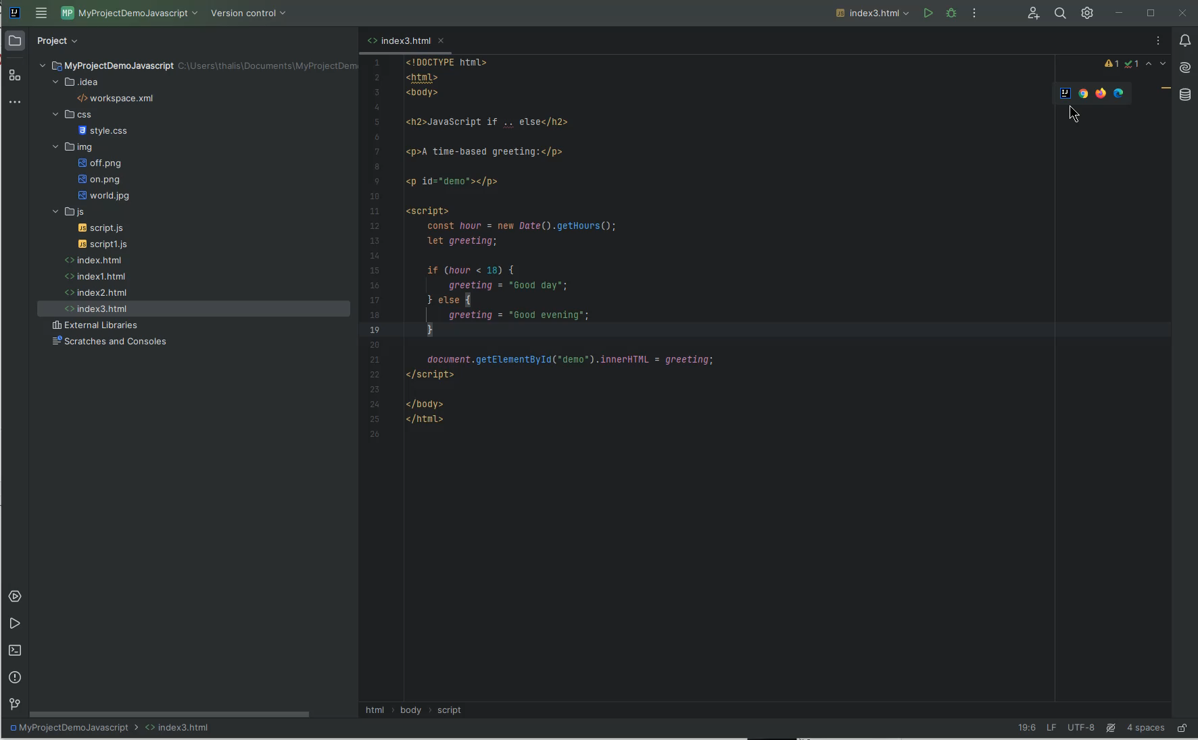
JavaScript Conditions

Slide 29
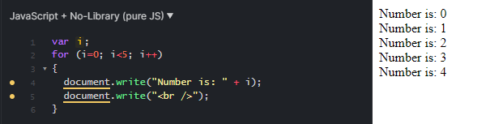
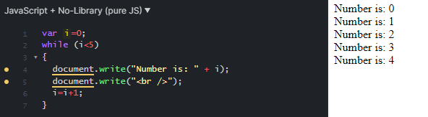
JavaScript Loops
for (Initial counter value; Condition; Counting step) {
// code block to be executed
}
Example:
while (condition) {
// code block to be executed
}
Example:

Slide 30
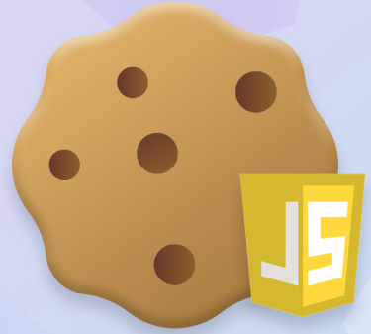
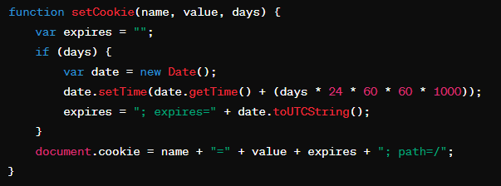
JavaScript Cookies
Cookies are small text files that are stored on the computer and contain data in the form of name=value pairs. For example: visitor=vist123.
To write (or store) and read cookies on the machine, the command used is document.cookie. document.cookie = "cookieName=cookieValue";
Overall, the cookie is stored as a string, and any additional parameters you can pass are separated by a question mark (;).
Example: document.cookie = "userid=Fe80gRCCijyH4mgdO; expires=Sun, 13 Jun 2021 20:31:59 GMT; path=/“
This is a JavaScript function to create a cookie:
Cookies store user/visitor information
When a browser requests a web page from the
server, page cookies are added to that request

Slide 31
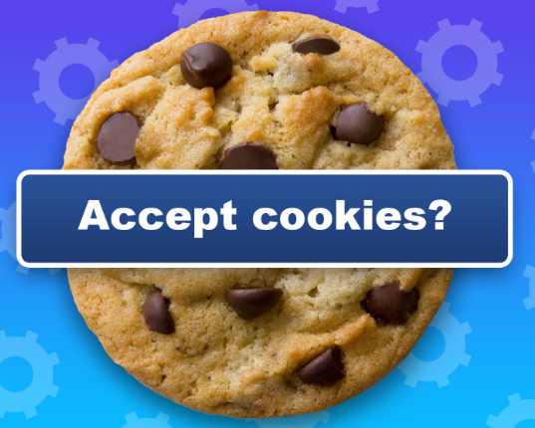
Privacy concerns
Tracking
Profiling
Data Collection
Third-Party vs First-Party Cookies
How to protect
Browser Privacy Settings: private browsing, cookie blocking, and third-party cookie restrictions
Cookie Blockers, extensions or browsers
Anonymization with Tor (not 100% safe)
Use of Tails, a portable operating system that protects against surveillance and hides your identity

Slide 32
Object-Oriented Programming With JavaScript ( OOP)
The JavaScript language has been designed on an object-oriented basis. With OOP a developer can:
Create their own objects and organize better the code by making it more flexible and maintainable
Use the pre-made built-in objects provided by JavaScript (JSON, Date, Math)
We use OOP to model or better describe real-world examples
The objects can contain data or methods. With objects we incorporate the data and their behavior into a block of code
Objects can interact with one another
We can use an API methods to access and communicate with the object

Slide 33
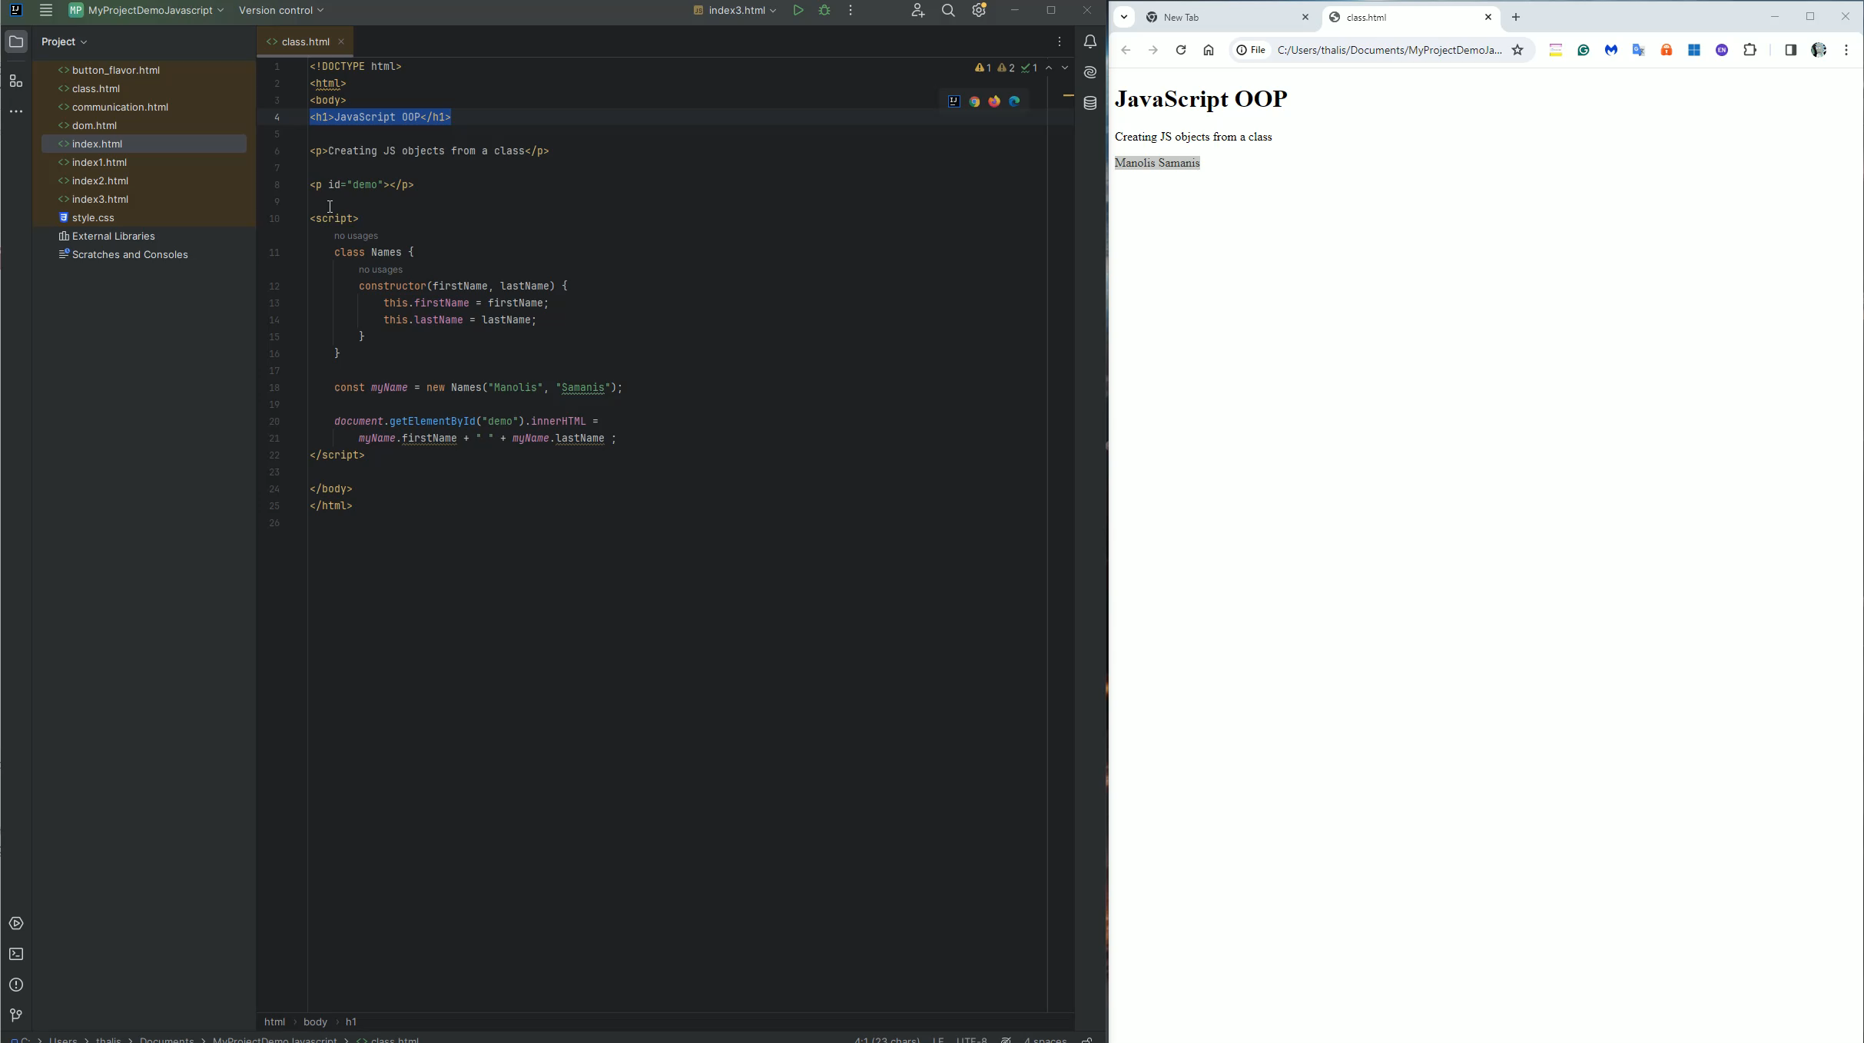

Slide 34
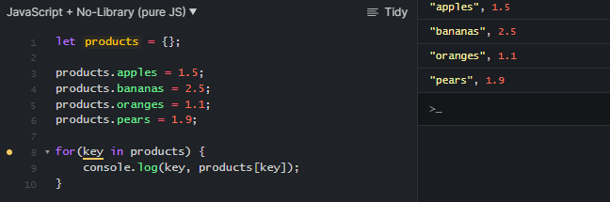
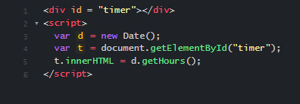
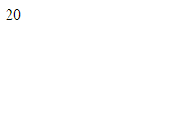
JavaScript Built-in objects
JSON (JavaScript Object Notation) is used for storing and transmitting data, primarily in web applications.
JSON objects share many similarities with Array objects.
Data is recorded in the format key:value.
Example:
The date object is used for managing dates and times
Example:

Slide 35
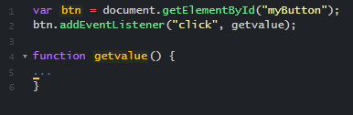
Objects and Instances
In JavaScript, anything stored in a variable is an object. To use an object, we first need to create an instance of that object.
Creating an object is done using the new operator -> var d = new Date();
Each instance (or object, as we will call it) has:
Properties or characteristics (features, properties, or fields)
Functions or methods
Ability to handle events
An object can have sub objects (child objects) -> window.document
To add an event handler, we use the method -> addEventListener("eventname", functionname);

Slide 36
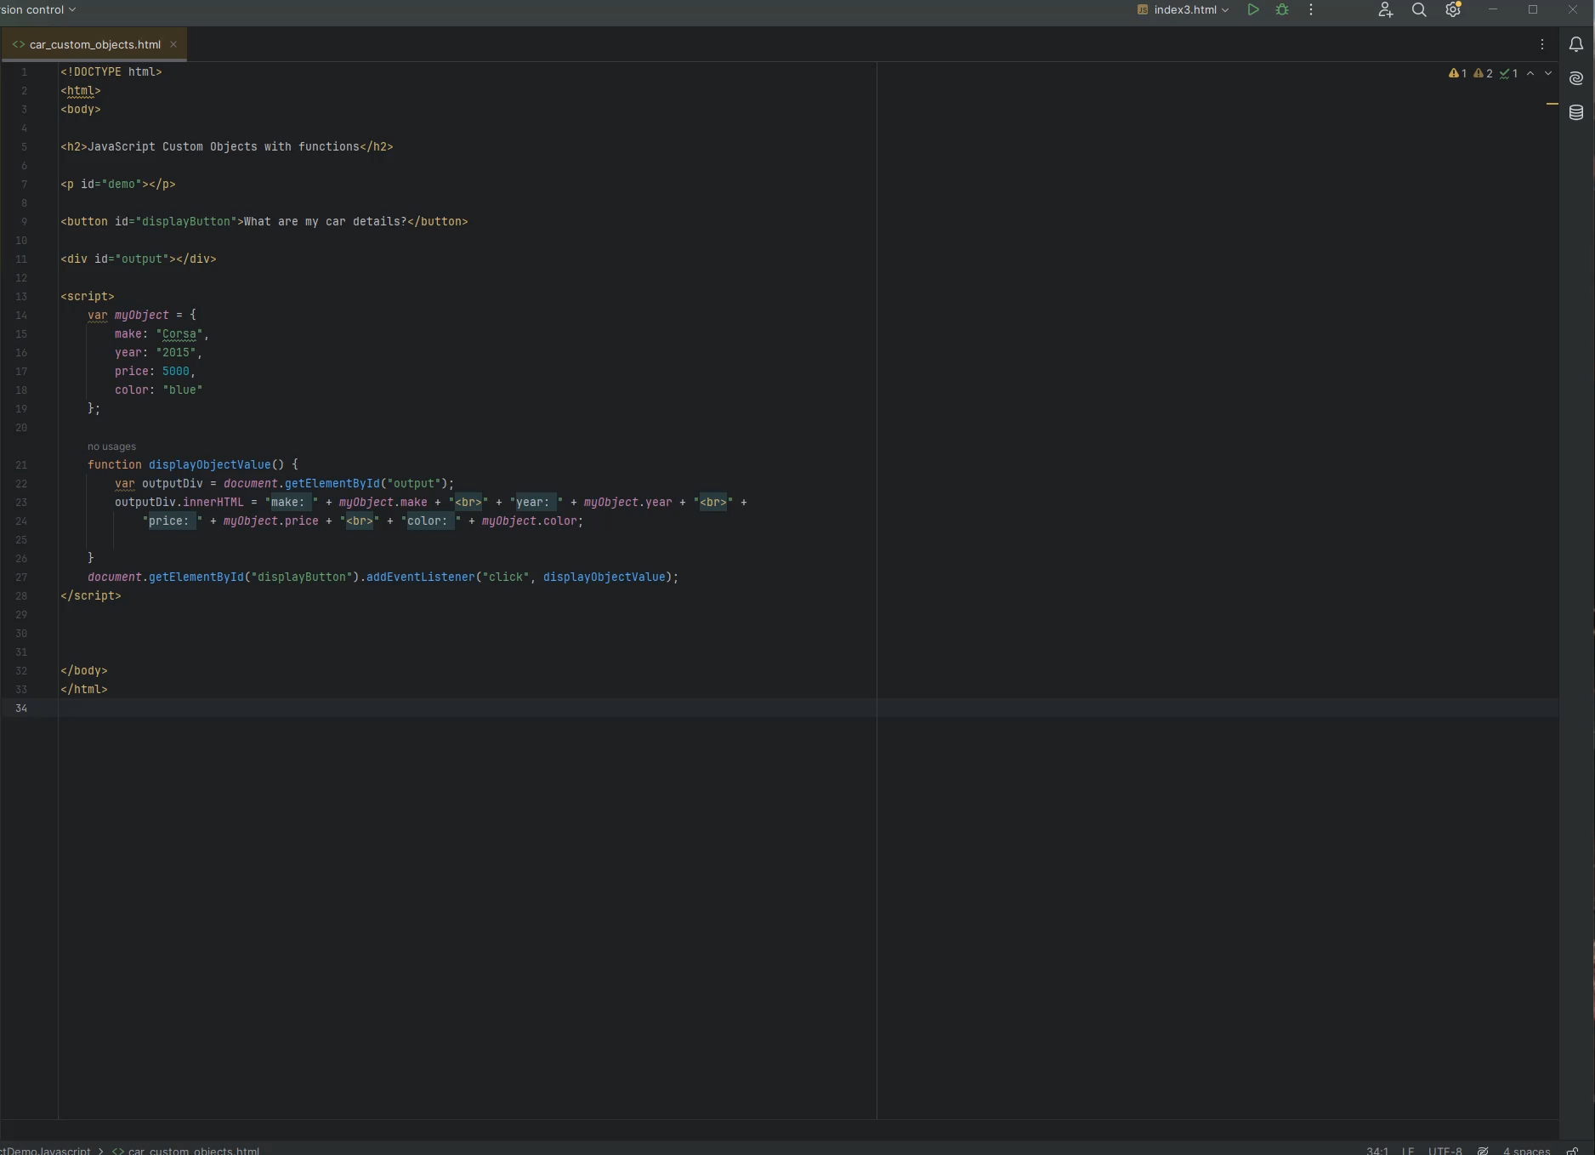
JavaScript Custom Objects with functions

Slide 37
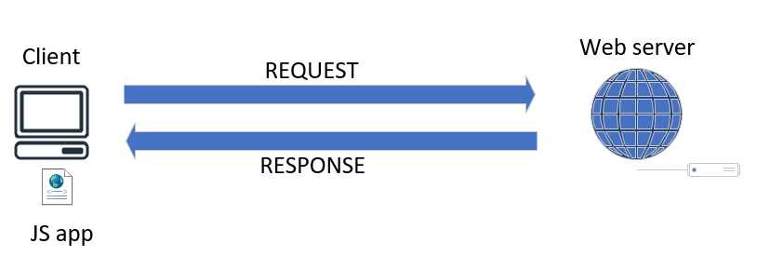
Asynchronous JavaScript and AJAX
AJAX (Asynchronous JavaScript And XML):
It can communicate with remote web servers in an asynchronous manner
It requests data from web servers dynamically

Slide 38
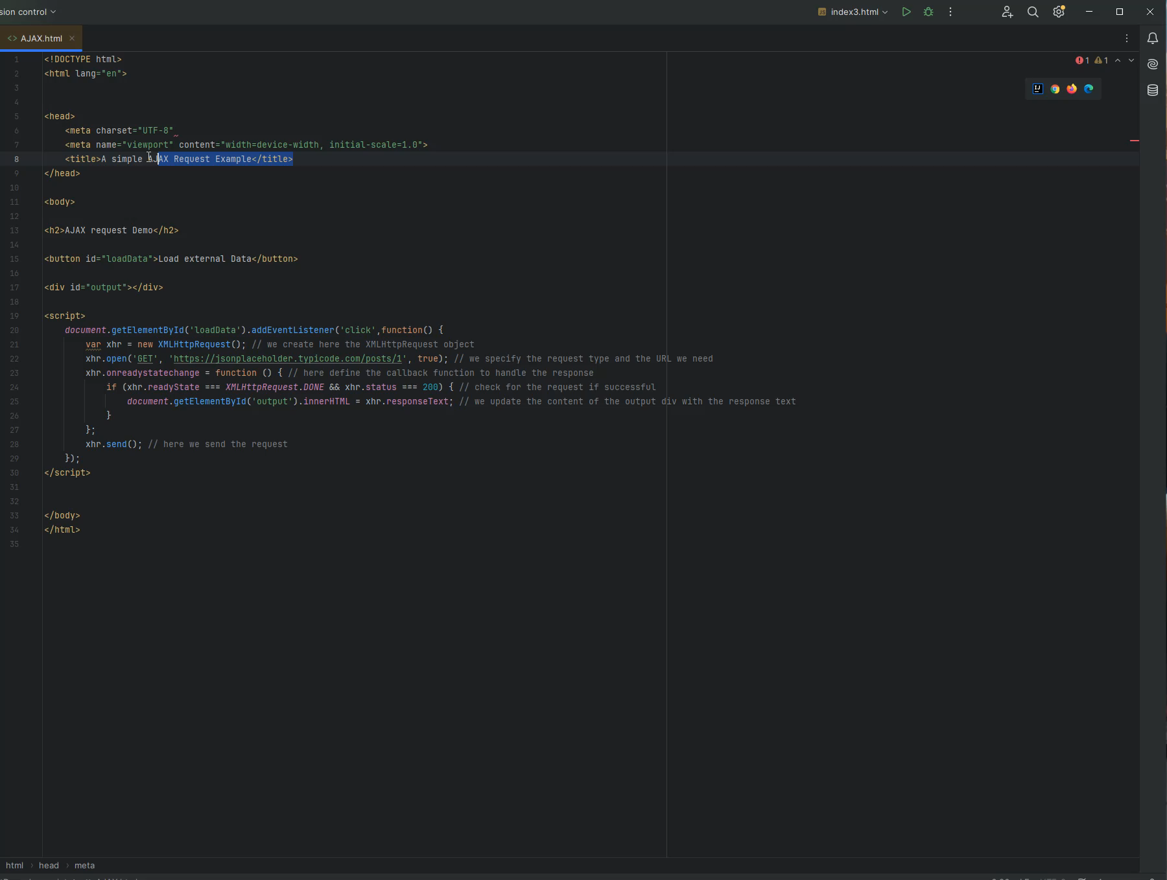
Asynchronous JavaScript and AJAX

Slide 39
Suggested resources for further reading
https://developer.mozilla.org/en-US/docs/Learn/JavaScript
JavaScript: The Definitive Guide, Author: David Flanagan

Slide 40
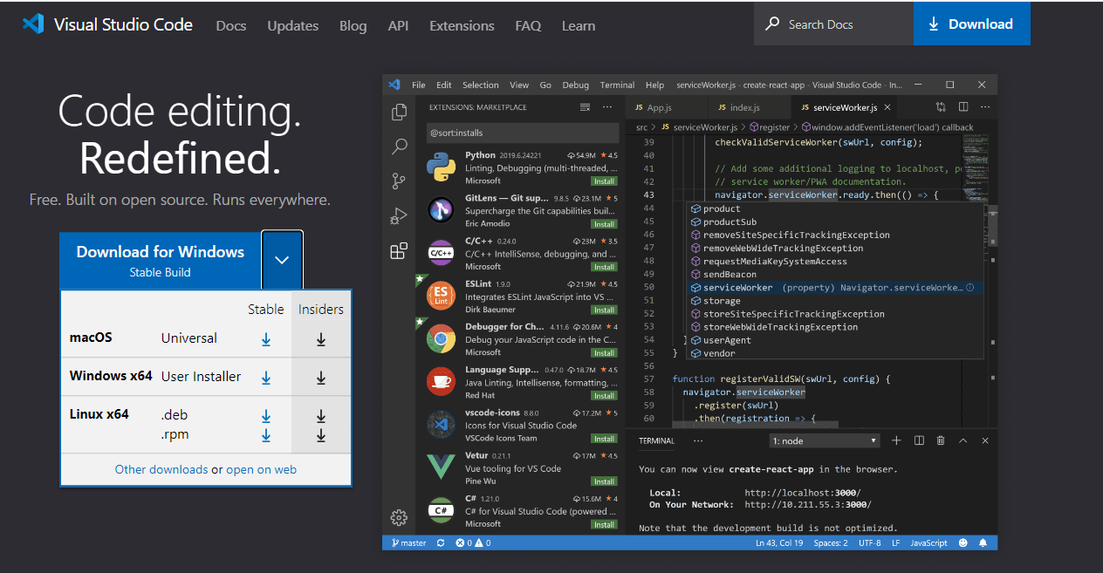
JS editor VS code

Slide 41
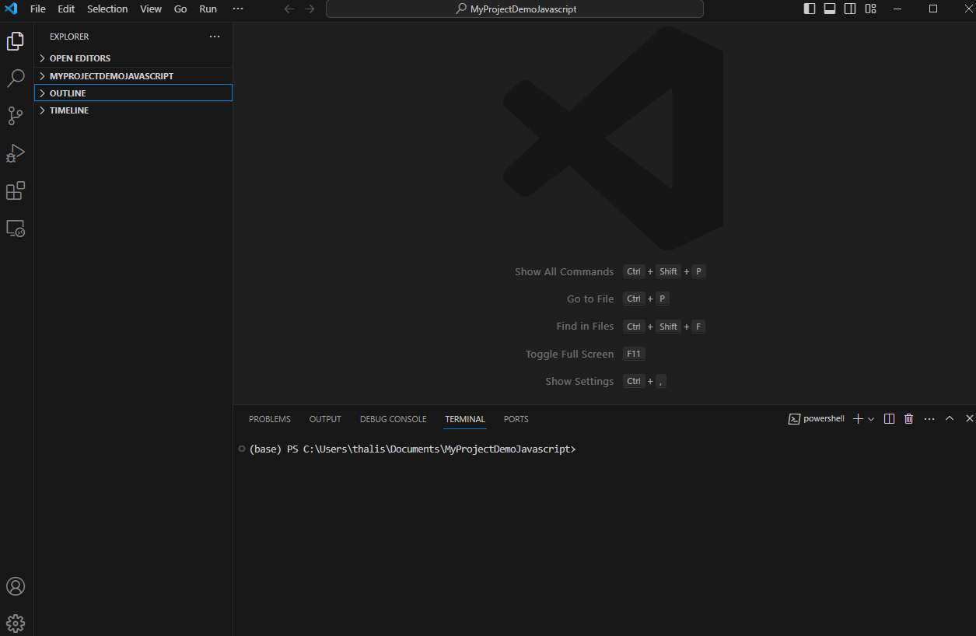
JS editor VS code

Slide 42
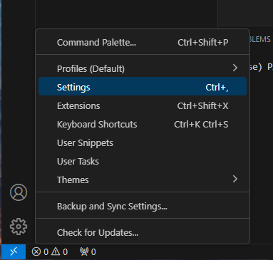
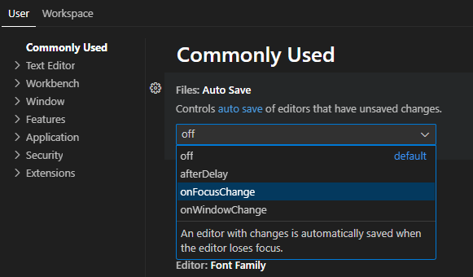
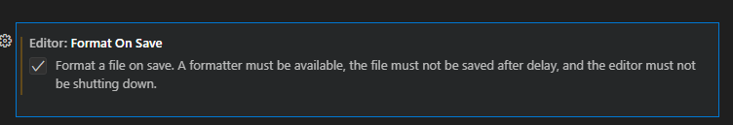
JS editor VS code

Slide 43
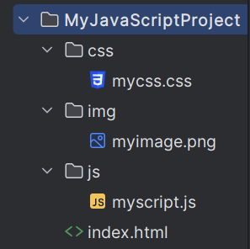
How to organize your project folder and file structure
<link rel="stylesheet" type="text/css" href="css/mycss.css">
<img src="img/myimage.jpg"></img>
<script src="js/myscript.js"></script>

Slide 44
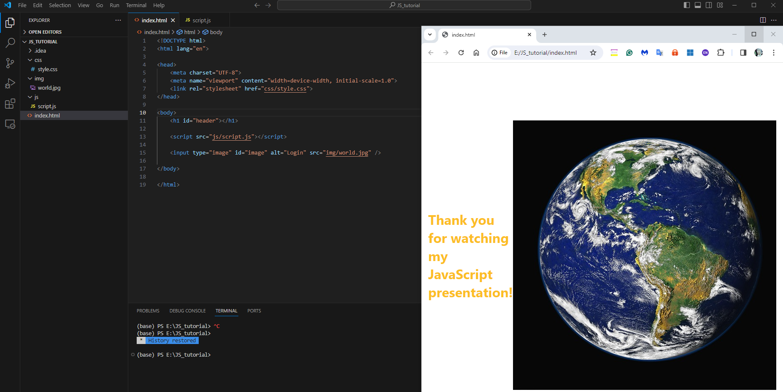
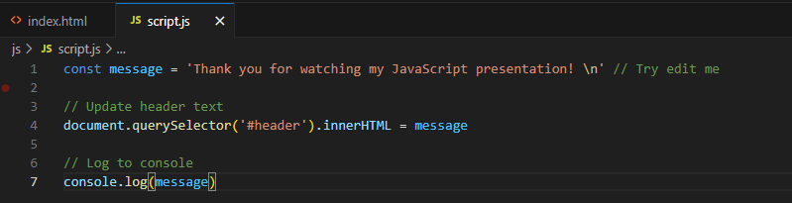
JS editor VS code
Thank you for watching my JavaScript presentation

Slide 45

Have any questions?

